Slide 1
U.S ELECTORAL SYSTEM
U.S electoral campaigns and political parties
Notes:
The US electoral system a complex but procedural process that is outlined in the constitution including the dates of each activity or event from the start of campaigns to inauguration date. While the actual campaigns begins when it is about one year to the election, the process of election starts during voter registration. Before the campaigns start, the leading parties; Democrats and Republicans are engaged a series of activities with the purpose of preparation for the general election. The purpose of any political movement is to ascent to power so that they can implement their manifesto or philosophy as such they normally put in place all the strategies to win the final election. The parties will have to conduct the primaries to select their favourite candidates who are supposed to contest in the general election. In this presentation, I have covered the US electoral system centred around the campaigns and political parties leading to the election.

Slide 2
U.S electoral campaigns
A political campaign is a planned efforts that aims to influence a certain direction of decision making process of a country or party.
The campaigns leads to the election where candidates are elected
Notes:
The president is elected through the federal state indirectly through an electoral college while the other local seats like congress, senate or governorship the holders are elected directly. These activities are normally referred to as electoral campaigns. In the US there are normally two types of elections in a single term they include; those for federal state and local government.

Slide 3
Functions of the political parties
Representing groups of interests. The constituents are the people represented by the elected officials. The constituents are represented by officials from different parties depending on who won the majority votes in the same constituent.
They also represent groups and individuals. Normally there are groups with special interests or concern.
Notes:
The concerns or the constituents are supposed to be represented or addressed by the elected leaders (Semetko, Blumler, Gurevitch, Weaver, & Barkin, 2013). In this case, the elected officials are supposed to represent not only the interest of the party but also the constituent in general in a non-partisan approach. The interest groups can be groups like urban African Americans, specific industries or an individuals with specific agendas.

Slide 4
Functions of political parties
Simplifying choices
There are two main political parties in the US, they aim to appeal to as many groups as much as possible.
There are two main political parties in the US, the Republicans and democrats;
Notes:
By simplifying choices, they state their goals to the voters so that to attract them to a wider philosophy but not just focussing a particular. Republicans philosophy is basically inclined to support business activities, size of government concern, social issues and conservative positions . The democrats base their philosophy on the support of minorities and labour and ague that the government has the capacity to solve several national problems.

Slide 5
Functions of political parties
Making policies
Political parties play a significant role in policy making however they are not policy making bodies entirely. The parties normally take specific positions on pertinent policy issues.
Notes:
The basis is to provide alternative to the position held by the party in power. The party in power always try to implement their philosophy through legislation. A candidate who wins majority votes in an election is given the mandate to implement the program stated in the campaigns.

Slide 6
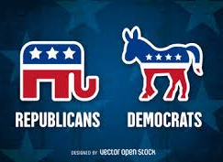
Types of political parties in the US
There are two major political parties in the US namely; the republican and the democratic party. There are also minor political parties such as; Vermont Progressive Party, Libertarian Party, Working Families Party, Green Party, Independence Party of New York and there is also the Independent.
The Democratic Party mainly promotes liberalism while the Republican Party is founded on conservatism.
Notes:
Despite the presence of numerous parties the Republican and Democratic Party are the dominant, these parties have shared power in between since independence and they are founded on specific ideologies. The two parties have dominated the American politics since independence in that if one is in power then the other will be in opposition to check on the government and they also have a huge following in the country.

Slide 7
Ways in which U.S. Citizens participate in election
Voter registration
For one to be eligible to vote in any election in the US, the individual must be a registered voter and therefore being a citizen alone doesn't guarantee one to vote.
Notes:
In this case therefore a citizen must register as a voter to qualify for voting (Dalton, & Wattenberg, 2002). Technically, the voting process begins at registration and therefore when citizens register as voters it is one way in which they participate in elections.

Slide 8
Ways in which U.S. Citizens participate in elections
Joining a political party. Joining a political party is one way in which the US citizens show their participation in the election.
Voting. The final stage of an election is voting for specific candidates or parties.
Notes:
By joining a political party the individual will be showing support for the particular party in context. The two main political parties that have dominated the US politics includes; the Democrats and Republicans. The Democrats is mainly supported by ethnic minorities and working class while the Republicans is mainly supported by wealth white people and the big business individuals in the country. Also, the US citizens can participate in an election by voting, as such when a citizen votes, the individual will have participated in an election.

Slide 9
Ways in which the US citizens participate in election
Standing for election. A US citizen can participate in an election by vying in any seats provided with an intention of emerging the winner hence representing that constituent.
Support or join interest groups. One can join these groups and then campaign for candidates vying in this category.
Notes:
Vying for a political post gives means the individual wants to serve the country and implement the policies he/she vied for and in so doing they will have participated in an election. For example Donald Trump contested in the Republican primaries winning the ticket before contesting for presidential elections in which he won. Another way is joining an interest group. Through these groups they can also put pressure on the state or federal government on specific issues.

Slide 10
Ways in which US citizens participate in campaigns
Raising funds for a party or candidates. Fund raising is normally one way in which the political parties raise funds from their members so are the specific candidates (Farrell,& Webb,2000).
Campaigning for the candidates in an election. This is where an individual directly or indirectly campaigns for the preferred candidate or party. election.
Notes:
Election campaigns is an intensive process that involves money to facilitate the process. The money normally raised through donor contribution and fund raising drives is used to cater for aspects like advertisement and promotion, taking care of daily activities of the team like transport and food. Also, A US citizens can also decide to dedicate his/her time to campaign for the candidate by convincing other citizens to vote for the individual in an election.

Slide 11
Functions of the caucuses and primary elections in political campaigns
Functions of the caucuses elections
Caucuses are private activities run directly by political parties. The registered members of the caucus are charged with the responsibility of selecting the delegates , to do this they gather together to discuss the candidates to be selected (Green, Palmquist, & Schickler, 2004). However how the caucus process is conducted tend to vary depending with the rules of the party; for instance Republican and Democrats
Notes:
The delegates who are selected move in the next stage during a national party conventions to select a party presidential candidate who is now allowed to stand in the general presidential elections as candidates for that particular party. For Democratic caucuses, a candidate is required to get at least 15 percent of the vote in that category to win the delegates. The Republican caucuses is organized in a way that the winner takes it all.

Slide 12
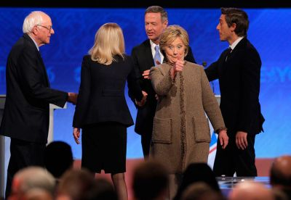
Functions of the caucuses and primary elections in political campaigns
Functions of the primary elections
The main functions of the primaries is to select party candidates to run for the general elections. Primaries can be closed or open. It can also be direct or indirect primaries.
The Republic Party primaries is organized in a way that the delegates are selected on the basis of the winner takes it all. Here the candidate with most votes wins the delegates.
For the Democratic Party primaries, a candidate who receives the votes percentage above the stated threshold wins it.
Notes:
Closed primaries implies that only the members can vote while open primaries implies that all voters are allowed to vote during party primaries. Also primaries can be direct or indirect. A direct nomination is one whereby voters directly vote decide the party's candidates. In an indirect primary, voters are supposed to elect the delegates whom thereafter choose the party candidates during the nominating conventions.

Slide 13
The role the national political party conventions play in the presidential elections
The sole purpose of national political party conventions is to select or choose party nominees for president during a convention meeting.
Notes:
The national political party conventions in the presidential elections are also required to adopt party principles statement with identified goals . Finally, they also adopt the rules and regulations for the party activities. An example for these rules is the next election cycle presidential nominating process.

Slide 14
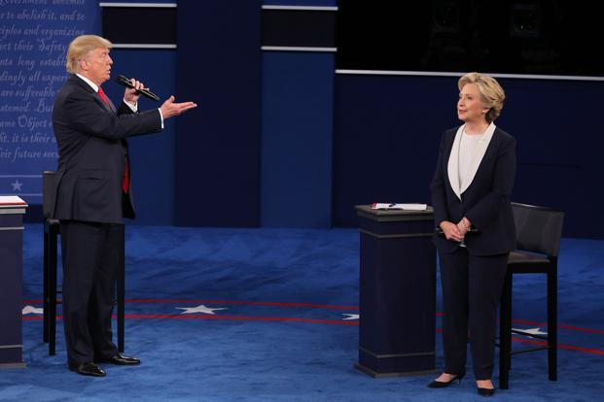
Presidential general election campaign process
The candidates
The candidates from the main political parties; the Republicans and Democrats start their campaign trails a year before the elections.
The debates
When the campaigns commence, candidates from the two parties participate in debates that are televised worldwide.
Notes:
The candidates for the leading parties; Democrats and Republican start campaigns a year to the election, at this stage, they form their campaign teams and start moving across the country to fundraise and rally support for their campaigns. After the candidates have kicked off campaigns, the first debate is organized which is televised worldwide. During the debate, candidates are asked tough questions in which they are supposed to answer. In the questions, they are required to talk about their policies and also be in position to defend their position and argue against the other candidates.

Slide 15
Presidential general elections campaign process
The primaries and caucuses.
The primaries and caucuses are organized in February.
The focus of the results is mainly in South Carolina and Iowa New Hampshire.
The Running Mates.
Around July the presidential nominees select their running mates
The National Conventions
Notes:
At around early February, the caucuses and primaries which are the main voting events that leads to delegates selection who will have to represent the citizens in the next convention starts. In July, the presidential nominees spirants begin announcing their running mate choices (Farrell, & Webb, 2000). These are individuals who will later become vice president if the aspiring nominee is elected the US president. The delegates from the caucuses and primaries selected at the National Conventions now get the chance to endorse the best candidates and in the end the presidential nominee of each party is announced officially to mark the end of the conventions process.

Slide 16
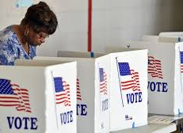
Presidential general elections campaign process
The electoral college
At this stage the representatives selected from every state and in proportion to population of the particular state vote to determine the president.
The general election
On November 8, American citizens go to the polls to choose the presidential candidates they want along with their running mates.
The Inauguration Day
Notes:
The electoral college members consists of 538 electors who are supposed to participate in the final voting process of the president. Out of the total of 538 electors, one must get at least 270 of the electoral votes to be declared the president. The college electors are supposed to vote in the general election on November 8.The voting the winning candidate for presidential election is announced and January 20th is always the inauguration day in the U.S. And it is held in Washington D.C. At the Capitol building. The first to be sworn in is the vice president and finally the President the inauguration ceremony is held on 20th January where the president and vice president take an oath.

Slide 17
The role of the media plays in modern political campaigns
Media as an informant
During the political campaigns, the media plays an important role of informing the public of the campaigns and any developing news.
The media is supposed to be neutral and impartial when reporting or covering news on political events and government activities.
Notes:
Media is involved in shaping how the citizens, observe and interpret political information. This is done by the coverage of political campaigns, events and elections. The media is also used to educate the public on registration and voting which are important process in an election. However in the modern politics sometimes the media has been misused during elections to spread propaganda hence being biased.

Slide 18
The role of the media plays in modern political campaigns
The media inform the public but also protect them from corrupt and incompetent political officials.
The media also provides critical information concerning the successes and failures of the available candidates or the government practices.
In the modern politics during elections, candidates use the social media platforms to reach the followers and internet.
Notes:
By acting as a watchdog, the media expose unethical and illegal practices to the public hence making sure the voters are well informed concerning the available candidates hence can make wise decisions, but this should not be a witch hand affair but rather open and impartial (Tumasjan, Sprenger, Sandner, & Welpe, 2010). When the media acts as the watchdog, they act as a guardian to the public.

Slide 19
The role and influence of money in modern political campaign
In modern politics, money defines politics, candidates line up rich donors to raise huge amount of money during campaigns.
Also in some situations where a candidate decides to petition the outcome of the election in courts, the individuals involved will require to hire good lawyers to represent them in courts. This requires money hence those with huge money have an advantage.
Notes:
The huge donations are influencing modern politics, through this, candidates can spend money in unlimited proportion on advertisements hence influencing elections unfairly. The candidates exploit campaign financial rules by overspending above the limit that is outlined, however sometimes the source of funds of the sponsors cannot be accounted for casting aspersions on the integrity of the candidate in context. In this case therefore it implies that a candidate who will not have billionaire donors will likely be disadvantaged hence the process will have been compromised in a way that it does not reflect the true picture of the will of people.

Slide 20
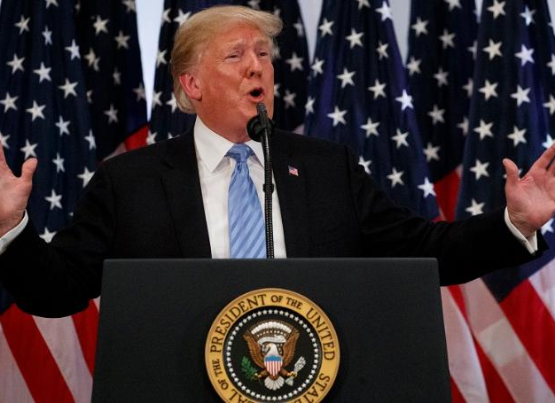
References
Semetko, H. A., Blumler, J. G., Gurevitch, M., Weaver, D. H., & Barkin, S. (2013). The formation of campaign agendas: A comparative analysis of party and media roles in recent American and British elections. Routledge.
Tumasjan, A., Sprenger, T. O., Sandner, P. G., & Welpe, I. M. (2010). Predicting elections with twitter: What 140 characters reveal about political sentiment. Icwsm, 10(1), 178-185.
Green, D. P., Palmquist, B., & Schickler, E. (2004). Partisan hearts and minds: Political parties and the social identities of voters. Yale University Press.
Dalton, R. J., & Wattenberg, M. P. (Eds.). (2002). Parties without partisans: Political change in advanced industrial democracies. Oxford University Press on Demand.
Farrell, D. M., & Webb, P. (2000). Political parties as campaign organizations. Parties without partisans: Political change in advanced industrial democracies, 102-128.
Notes:
The references outlined above have been referenced in the texts within the slides. The picture of the image in the slides is Donald Trump the US president making his speech. Trump emerged the winner in the 2016 presidential elections against Hillary Clinton in a hotly contested election period. The president underwent all the processes required to be declared the winner then sworn in. The winner of the general election becomes the president of the whole country not only his supporters, this means he is charged with the responsibilities of running the country to implement his policies as pledged during the campaign period. Donald Trump is currently the president of the United States of America.

